Slide 1

Predict Mobile Phone Pricing
Presented by: Atish Sanap

Slide 2

Contents of Project
Objective
Dataset Overview
Tools & Technologies
Model Architecture
Methodology
Training Results
Model Outcome
Conclusion

Slide 3

Objective:
Build a system that can predict pricing for a mobile phone using data on available phones in the market. Predict if the mobile can be priced low/med/high/very high. Explore the data to understand the features and figure out an approach.

Slide 4

Problem Statement:
In a highly competitive smartphone market, determining the appropriate price range for a mobile phone based solely on its technical specifications is a complex task. This project aims to build a machine learning model that accurately classifies mobile phones into predefined pricing categories—low, medium, high, or very high—based on hardware features, without relying on brand or external factors.

Slide 5
Dataset Details:
The dataset used in this project contains structured data on various mobile phone specifications and their corresponding price ranges.
It consists of 21 feature columns and 1 target column.
🔹 Target Column
Price Range – Indicates the price category:
0 = Low Cost
1 = Medium Cost
2 = High Cost
3 = Very High Cost

Slide 6
Important Features in the Dataset
Feature | Description
Ram | RAM capacity in MB — highly correlated with price
Battery Power | Battery capacity in mAh
px_height | Screen resolution height in pixels
px_width | Screen resolution width in pixels
int_memory | Internal memory in GB
mobile_wt | Mobile weight in grams
clock_speed | Processor clock speed in GHz
n_cores | Number of processor cores
four_g | 4G support (1 = Yes, 0 = No)
three_g | 3G support (1 = Yes, 0 = No)
touch_screen | Touch screen feature (1 = Yes, 0 = No)
wifi | WiFi availability

Slide 7
Tools & Technologies
Programming Language: Python
Libraries:
TensorFlow & Keras (for deep learning models)
OpenCV (image manipulation)
NumPy & Pandas (data handling)
Matplotlib & Seaborn (visualizations)
Development Environment:
VS Code, Jupyter Notebook or Google Colab

Slide 8
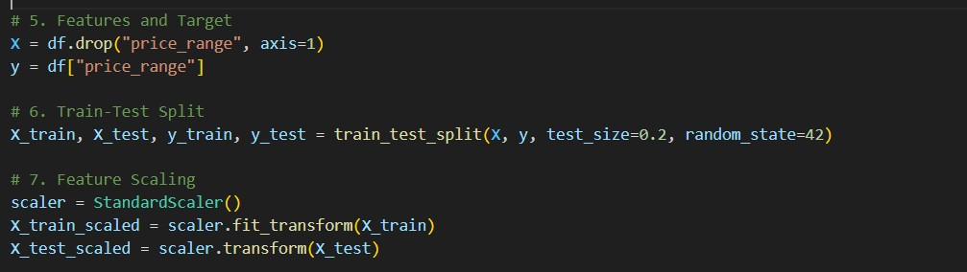
Components of Model Architecture
Raw Dataset: Structured data with 20+ technical features about mobile phones.
Feature Engineering: Selection of relevant features like RAM, battery, camera, resolution, etc., based on correlation or importance scores.
Train-Test Split: Divides data to train the model and evaluate its performance fairly on unseen data.
Feature Scaling: Ensures uniform scale across all numerical features, improving the performance of distance-based models like SVM.

Slide 9
Methodology
Data Exploration & Visualization
Checked basic statistics: df.describe(), df.info().
Used Seaborn heatmaps to analyze feature correlation.
Visualized distributions using boxplots and histograms.
Data Preprocessing
No missing values.
Scaled continuous variables (RAM, battery_power, px_height, etc.).
Split into X_train, X_test, y_train, y_test.
Model Building
Logistic Regression
Decision Tree Classifier
Random Forest Classifier
Support Vector Machine (SVM)

Slide 10
Hyperparameter Tuning
Used GridSearchCV to tune:
n_estimators, max_depth for Random Forest
C, kernel for SVM
Feature Importance
Identified that ram, battery_power, px_height, and px_width were the most influential features.
Data Exploration & Visualization
Data Preprocessing
Model Building
Feature Importance
Hyperparameter Tuning

Slide 11
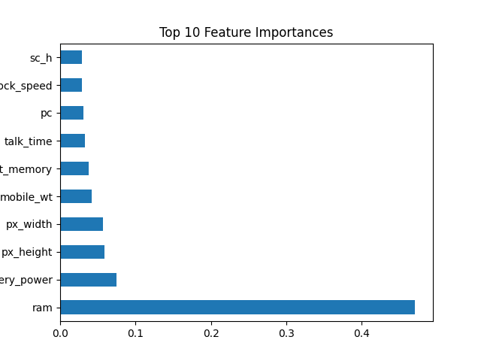
Training Results
Model | Accuracy (Test Set)
Logistic Regression | ~82%
Decision Tree | ~85%
Random Forest | ~89%
SVM | ~87%

Slide 12
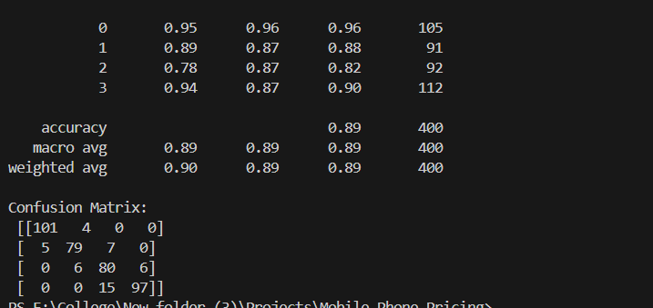
Model Outcome:
The final model can classify mobile phones into four pricing segments with high accuracy. Scalable: Can be deployed on e-commerce platforms or mobile pricing engines. Explainable: Outputs show which features contributed to the prediction. Predicts pricing purely based on hardware specs, making it fair and consistent.

Slide 13
Conclusion
The mobile pricing prediction project successfully demonstrates how machine learning can be applied to a real-world problem using structured data. The model accurately classifies phones into different price ranges.The most influential features were RAM, battery, and screen resolution.

Slide 14
Thank You !!!

